Slide 1




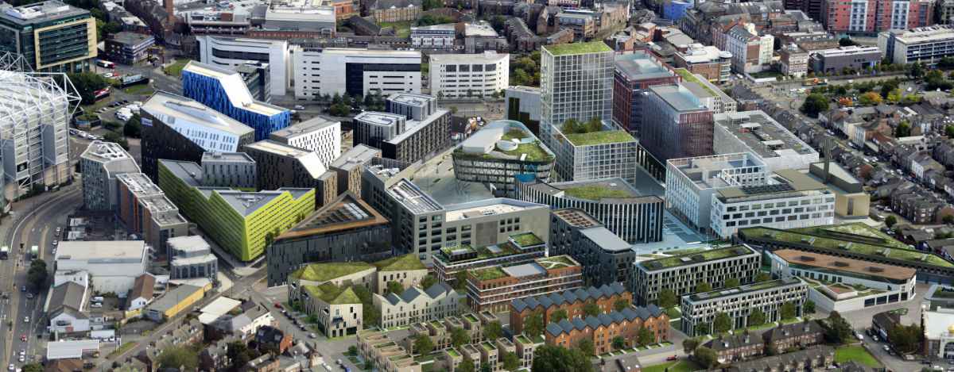


NetZero GeoRDIE
Net Zero Geothermal Research for District Infrastructure Engineering
EPSRC Decarbonising Heating & Cooling first round
with:
  David Manning, Mark Ireland, Mo Rouainia, Sara Walker, Yousef Akhlaghi, Tom Charlton, Mohamad Khalil and Hui Ben (Newcastle)
  Ole Pedersen (now Aarhus) and Anna McClean(Newcastle)
  Gioia Falcone, Rob Westaway†, Dave Banks, Chris Brown and Isa Kolo (Glasgow)
  Jon Gluyas (Durham)
  Rachel Brown and Sydnee O’Brien (Newcastle)

Slide 2
Partners
Newcastle City Council
“…use of the borehole as a research facility to support decarbonisation of heating is timely to inform Newcastle City Council’s target to be carbon neutral by 2030.”
The North of Tyne Combined Authority
“…[our] vision is one of a low carbon, sustainable future and the data from Net Zero GeoRDIE will inform the region’s transition to a low carbon economy.”
The Environment Agency
“…recognise the important role that this research has to play in informing the understanding of the environmental implications of heat extraction from deep boreholes.”
Engie
“…understand how new approaches and technologies can inform the understanding of how we might ‘re-imagine’ the use of the subsurface in the future.”
Schlumberger
“…anticipate that the research outputs will provide insights to the development of new tools and technologies for supporting the growing geothermal industry.”
Geon
“…this is an important opportunity to improve data on deep geothermal heat generation, which we believe will play an important part in the UKs transition to Net Zero.”
South Tyneside Council
“…the opportunity to understand the potential for geothermal energy to supply local buildings.’”
EnviroCentre
“…understanding the heat extraction potential of unused and abandoned wells.”

Slide 3
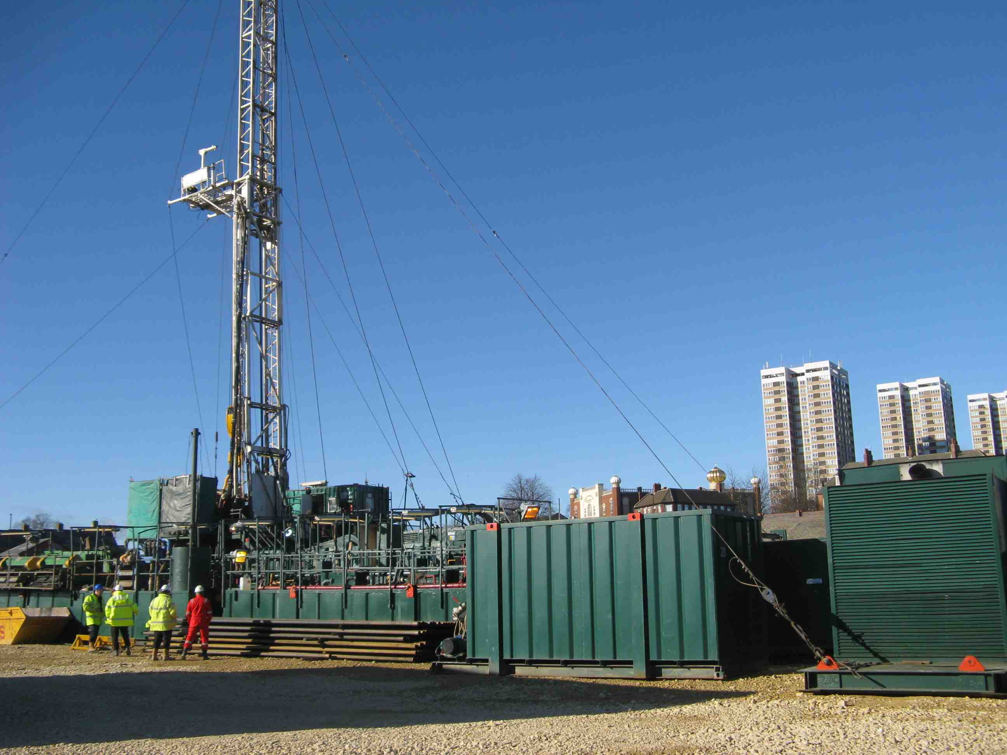
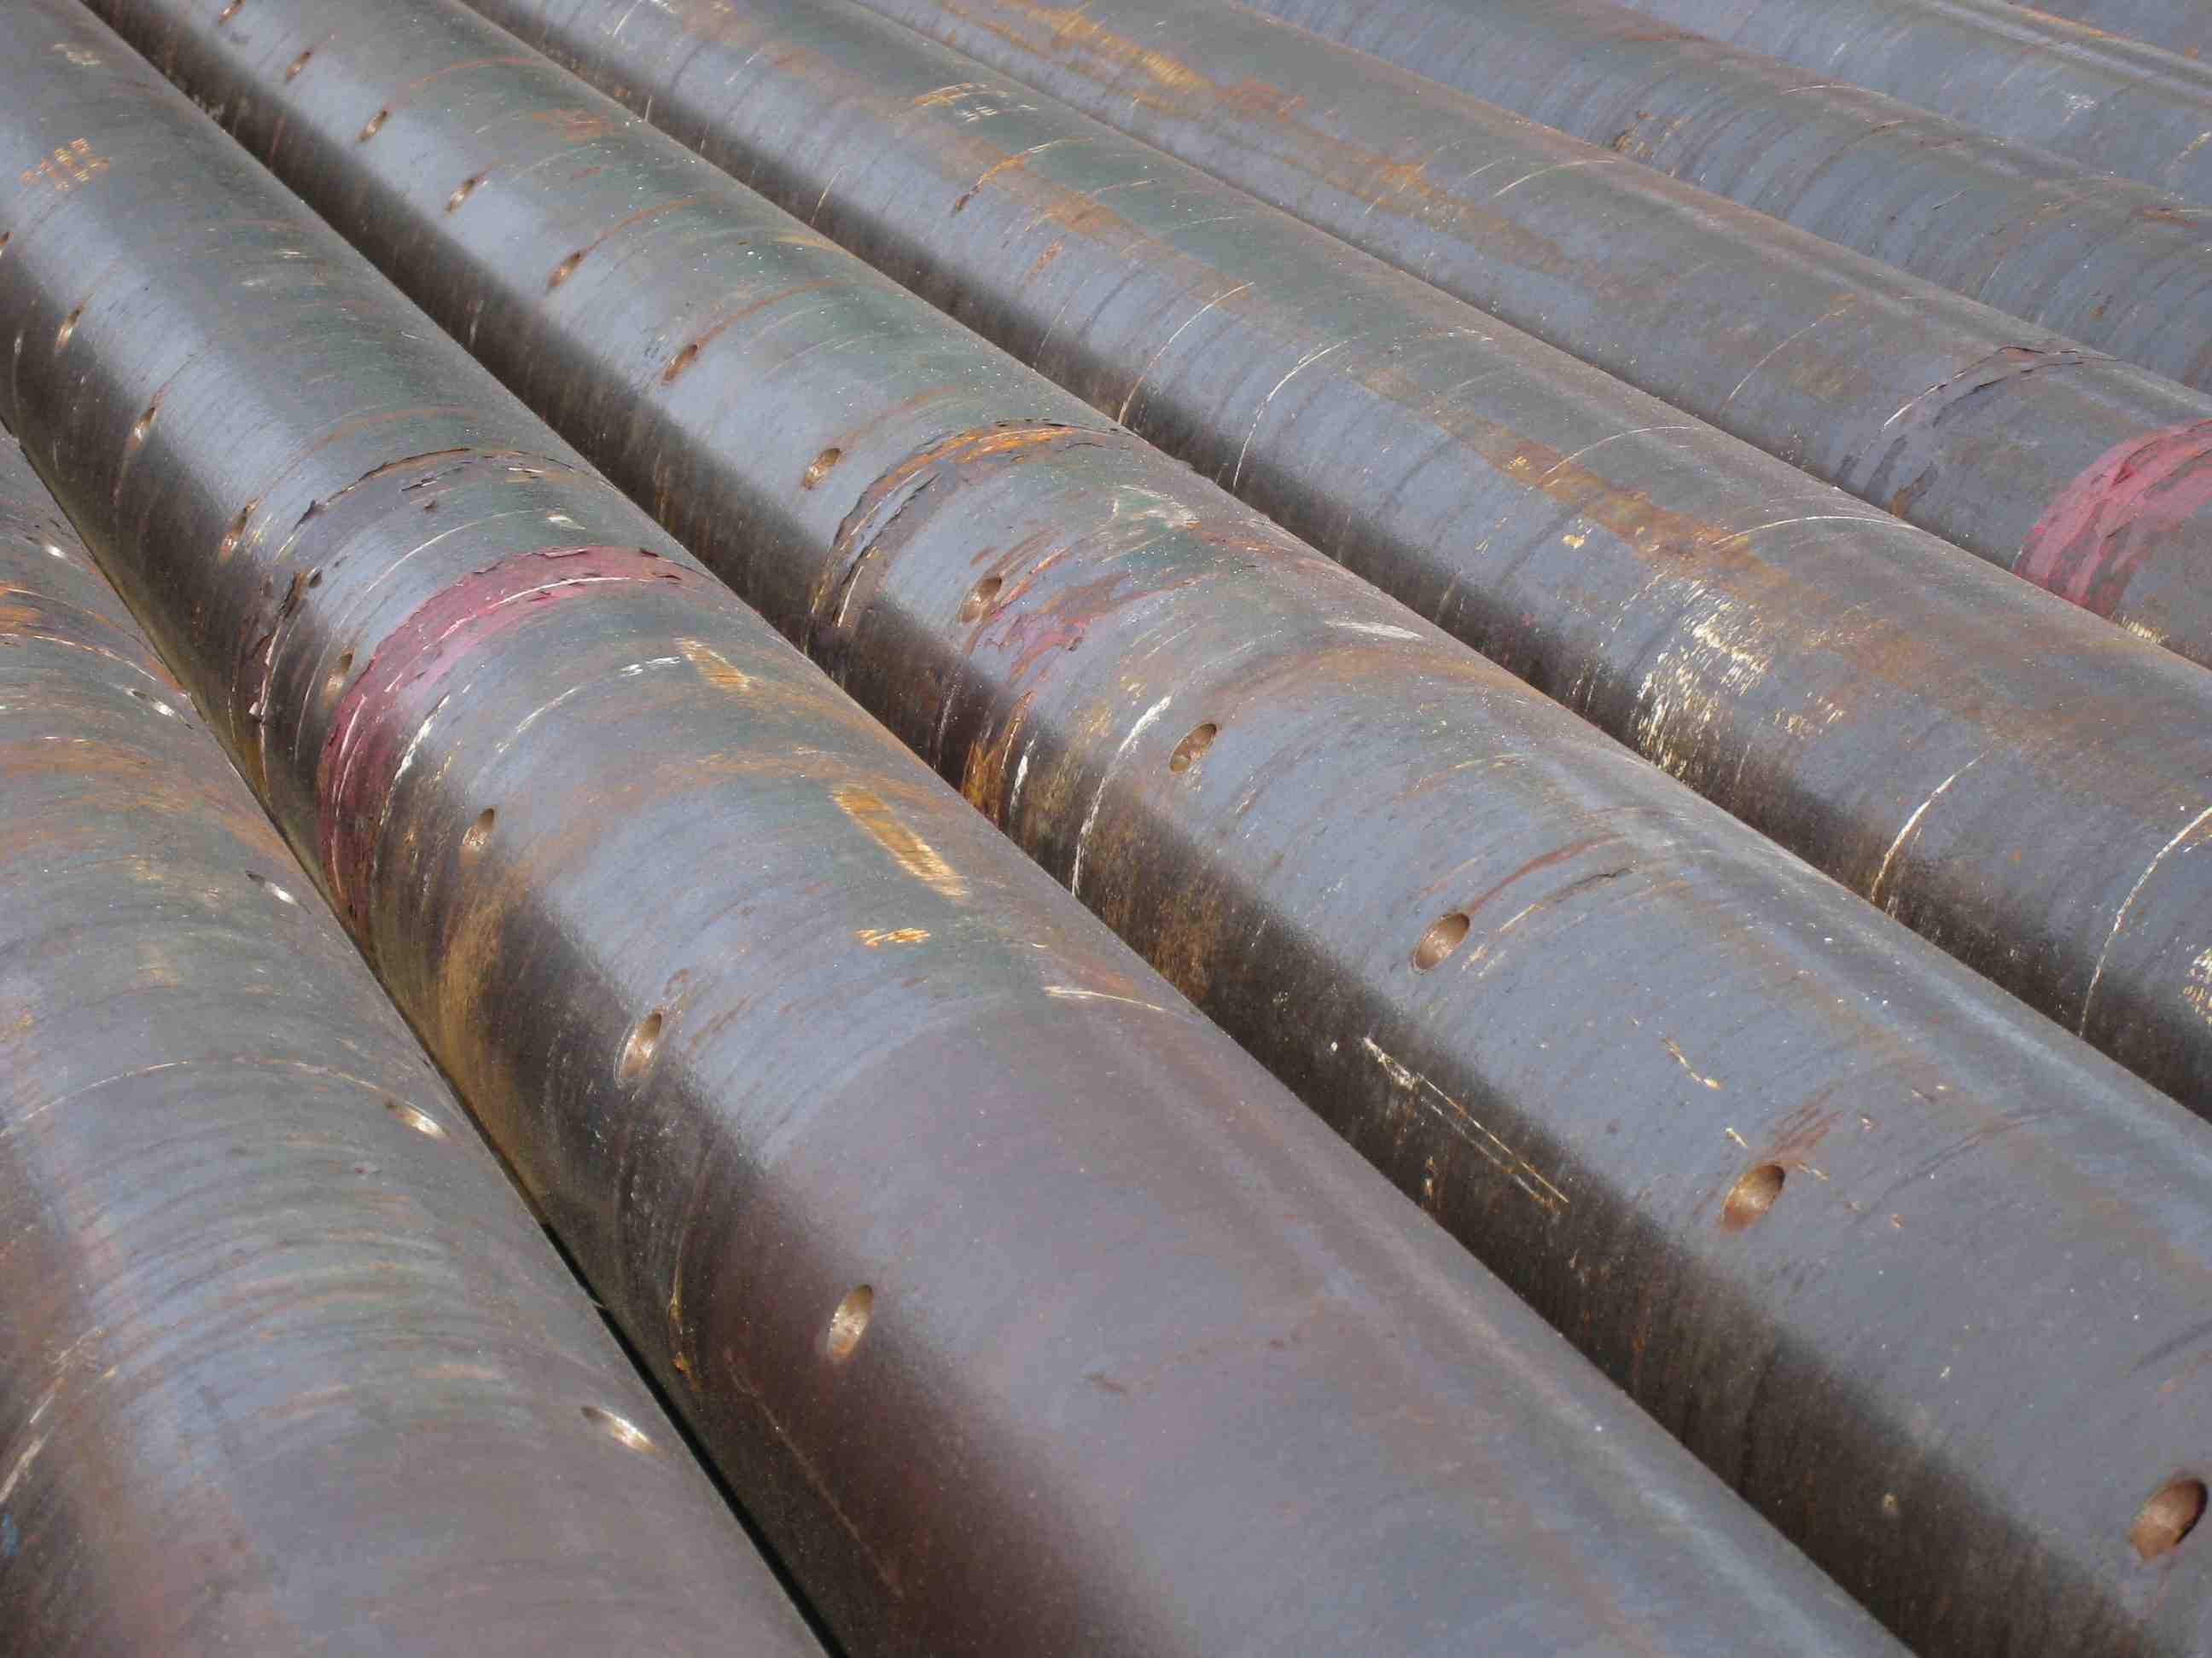
The Newcastle Geothermal well (completed 2014): 1640 metres deep

Slide 4
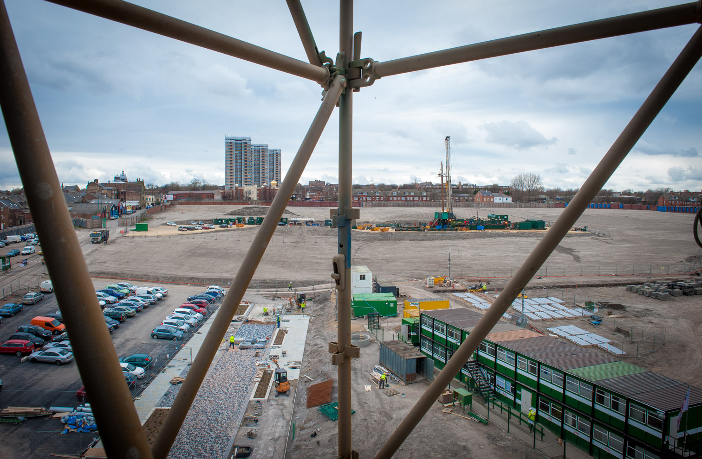
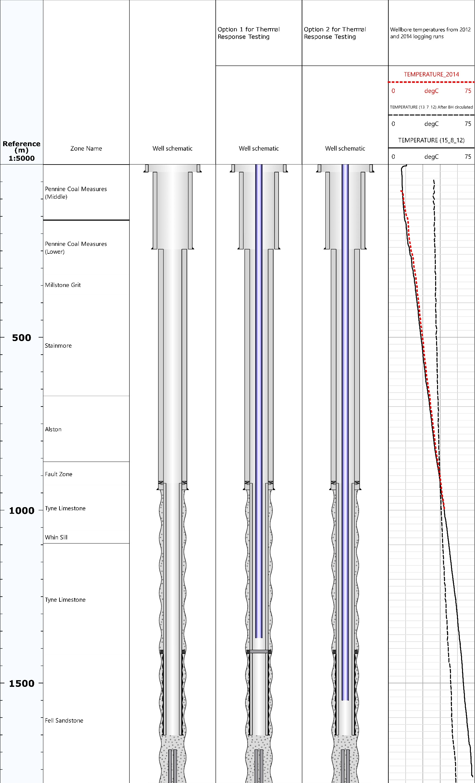

Slide 5
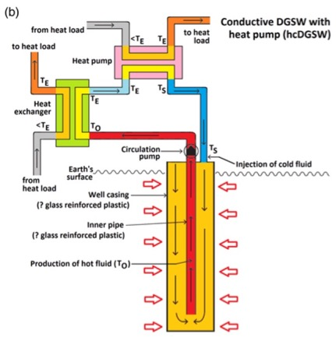

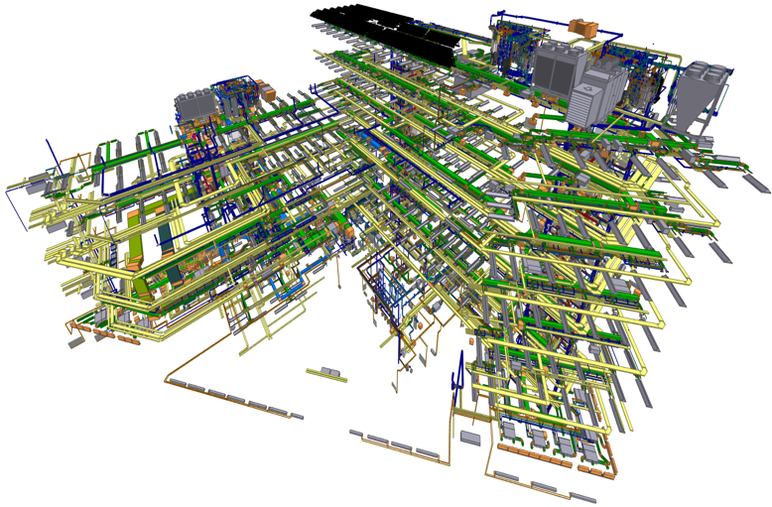
How can a deep hole supply the energy needs of a modern building?
Urban Science Building, next to the well

Slide 6
Modelling, measurement, management
Do well heat yields match demand?
What are the regulatory issues?
What are the building heating/cooling loads,
present and future?

Slide 7
Informs city centre heating and cooling schemes

Slide 8
Project Plan
Six areas covering both research and engagement
Modelling of heat transport within the rock mass and wellbore
Uncertainty modelling
Wellbore facility activities
Integration of heat to an energy network and the end users
Regulatory and legal implications
Stakeholder and public engagement

Slide 9
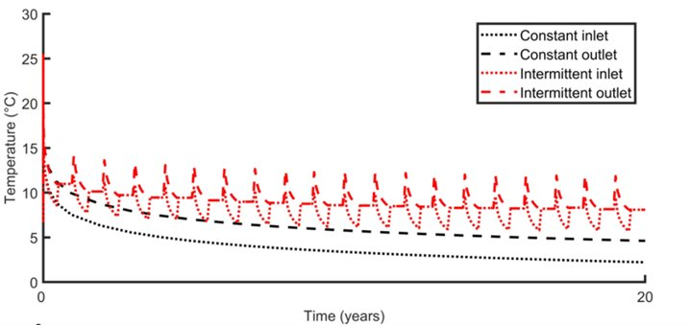
University of Glasgow Modelling Studies
Various numerical models can be used to simulate heat flux.
Varying heat loads that can be imposed on the borehole heat exchanger and whether these can meet the building heat load for nearby buildings. Modelling includes:
  Parameterisation studies
  Scalability studies
  Subsurface and surface coupling studies
  Statistical analysis
Initial results show that:
  A heat load of >50 kW can be imposed for a heating season (figure 1a).
  Modes of operation are essential to planning of operational heat loads (figure 1b) as higher heat loads can be imposed on the borehole with intermittent operation.
Brown, C.S., Kolo, I., Falcone, G. and Banks, D., 2023. Investigating scalability of deep borehole heat exchangers: Numerical modelling of arrays with varied modes of operation. Renewable Energy, 202, pp.442-452.
Kolo, I., Brown, C.S., Falcone, G. and Banks, D., 2022. Closed-loop Deep Borehole Heat Exchanger: Newcastle Science Central Deep Geothermal Borehole.
Figure 1: Implications of (a) imposing different load over a heating season and (b) methods of operation over the lifetime of a deep borehole heat exchanger. Kolo et al., 2022 and Brown et al. 2023.

Slide 10
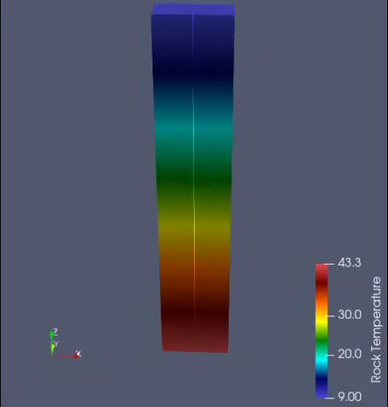
50 kW can be extracted in the long-term, over 25 years.
There is thermal draw-down with a concave up orientation towards the DBHE as seen from the rock temperature contours.
Thermal draw-down is high in the initial years but a quasi-steady state is reached after ~10 years.
The radius of thermal influence is ~60m from the DBHE, measured to within 0.5 degree of initial conditions.
Radius of thermal influence increases with depth as more heat is extracted from the deeper section of the DBHE. The radius of thermal of influence is ~40m at 161 m depth but increases to 60 m at the bottom of the DBHE.
Kolo, I., Brown, C.S., Falcone, G. and Banks, D., 2023. Repurposing a Geothermal Exploration Well as a Deep Borehole Heat Exchanger: Understanding Long-Term Effects of Lithological Layering, Flow Direction, and Circulation Flow Rate. Sustainability, 15(5), p.4140.
Brown, C.S., Kolo, I., Falcone, G. and Banks, D., 2023. Investigating scalability of deep borehole heat exchangers: Numerical modelling of arrays with varied modes of operation. Renewable Energy, 202, pp.442-452.
Kolo, I., Brown, C.S., Falcone, G. and Banks, D., 2022. Closed-loop Deep Borehole Heat Exchanger: Newcastle Science Central Deep Geothermal Borehole. In: European Geothermal Congress 2022, Berlin, Germany, 17-21 Oct 2022, ISBN 9782960194623
Rock temperature around the DBHE showing thermal draw-down with time for 50kW extraction. Slice is taken at the mid y-plane

Slide 11
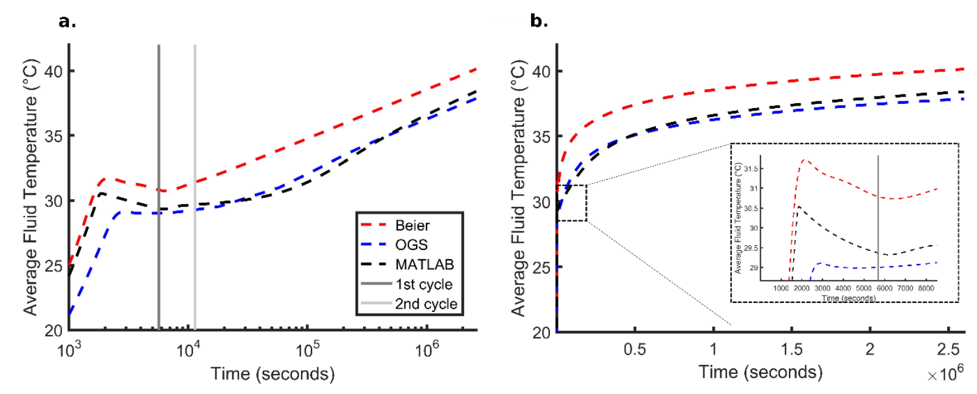
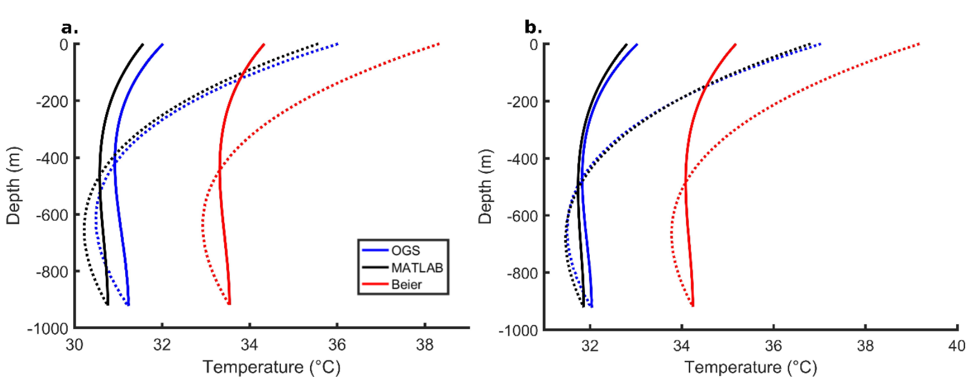
Modelling Deep Thermal Response Tests
Comparison of different software for modelling thermal response tests (TRTs).
Parameters: 50 kW heat load, circulation rate of 3 L/s through the annular space with extraction through the central pipe (i.e., CXA). Ground thermal conductivity of 2.55 W/(m.K).
Critical time for the Line Source Method (i.e.,Tcrit) was 15h. Therefore, results should be valid after this time.
At the end of the simulation the average fluid temperature plotted against time is parallel for all approaches (figure 2).
Beier’s solution produces elevated temperatures by 2.3 °C (recorded at the end of the simulation).
When using the Line Source Method, Beier’s solution provides the best estimate for thermal conductivity in comparison to the model inputs (2.55 W/(m.K)).
Figure 2: Evolution of apparent average fluid temperatures with time for each modelling approach using a logarithmic x axis (a) and linear (b).
Figure 3: Evolution of inlet and outlet temperatures plotted against depth for each modelling approach for 3 days (a) and 5 days (b). Dashed line is the inlet fluid through the annulus and solid line is outlet through the central pipe.
Brown, C.S., Kolo, I., Banks, D., Doran, H.R, and Falcone, G., 2023. Modelling Thermal Response Tests for Deep Coaxial Borehole Heat Exchangers. Accepted for publication in the World Geothermal Congress, Beijing, 2023.

Slide 12
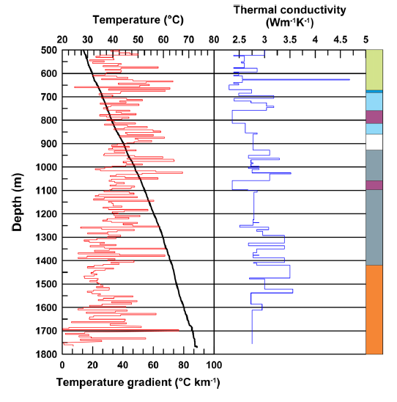
Uncertainty analysis of the performance of a deep BHE at Newcastle Helix (Newcastle team)
Objectives:
Explore effect of variability of key parameters on short and long-term deep coaxial BHE performance.
Represent spatial variability by random fields.
Address computing cost with HPC/surrogate models.
Variability of temperature and thermal conductivity at Science Central Borehole (Younger et al, 2016)

Slide 13
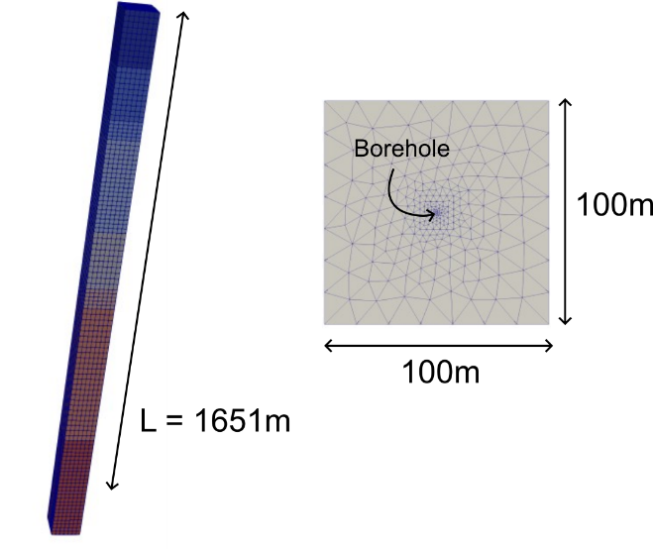
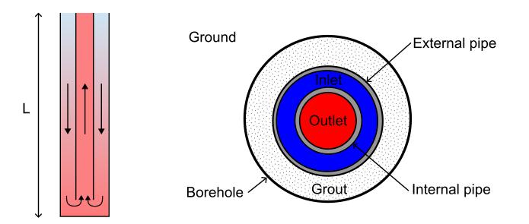
Analytical model
Uncertainty analysis
DBHE setup
FE model
    Aim: explore effect of variability of key parameters on short and long-term deep coaxial BHE performance
    Uncertainty analysis requires fast models (or surrogate models)
    Beier (2020) analytical solution compared with FE model of Science Central borehole as a 1651m deep BHE for short term (30 day) extraction of 50kW
Analytical vs FE

Slide 14
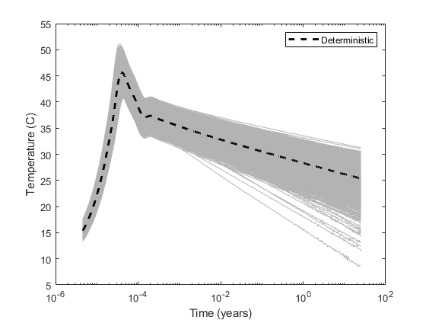
Uncertainty propagation
Uncertainty analysis
    Simulated 50kW heat extraction over 25 years (long term)
    Quantification of sources of uncertainty:
    Results show potential variability in productive life
    Sensitivity of the outflow temperature changes over time
Monte Carlo
Name | Description | Unit | Distribution | Parameters | Uncertainty (%)
r_{b} | Borehole radius | m | Uniform | [0.1006, 0.116] | 7
k_{s} | Ground thermal conductivity | W/(mK) | Gaussian | [2.67, 0.534] | 20
c_{s} | Ground volumetric heat capacity | MJ/(m³K) | Gaussian | [2.32, 0.464] | 20
k_{g} | Grout thermal conductivity | W/(mK) | Gaussian | [1.05,0.0525] | 5
c_{g} | Grout volumetric heat capacity | MJ/(m³K) | Gaussian | [1.824, 0.0912] | 5
w | Flow rate | L/s | Gaussian | [8.33, 0.42] | 5
T | Surface temperature | °C | Uniform | [8, 10] | 11
gg | Geothermal gradient | °C/km | Uniform | [30, 36.7] | 10
Sensitivity
Geothermal gradient
Thermal conductivity

Slide 15
Wellbore facility activities
Thermal response tests
Measure how much heat can be recovered using a circulating fluid
To obtain data to calibrate and refine the models
Currently in procurement

Slide 16
T°C_{outlet}
TRT / Heater
T°C_{inlet}
Flowmeter
Temperature sensor string in annulus for return temperature (~460m)
Assumed SD11 O.D 60 – 75 mm
Fibre optic cable in tubing for DTS (continuous temperature)
Distance between bottom of pipe and shoe to be determined
Blank plate at 7” casing shoe
Notes:
Simplified well recompletion

Slide 17

Integration of heat to an energy network and the end users

Slide 18
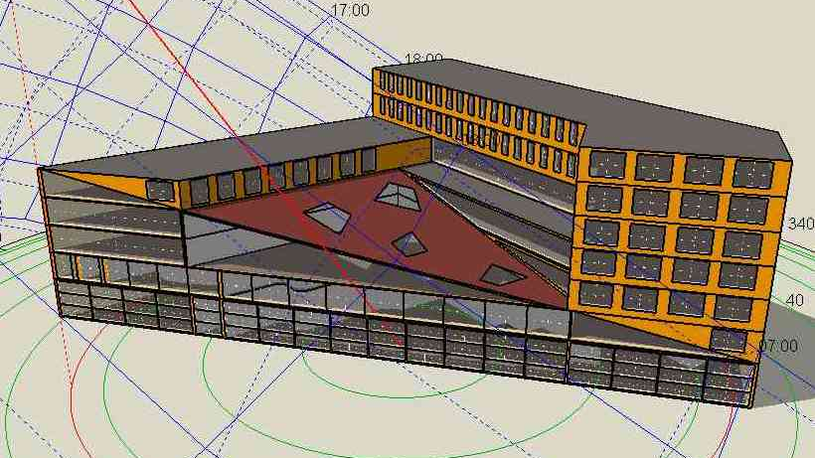
USB building energy model
(Ben, et al., 2023)

Slide 19
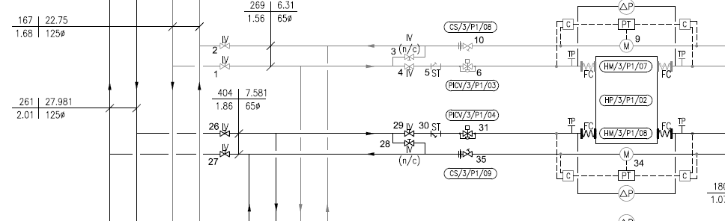
Gas boiler injection
Hng
47/40°C F&R
Urban Sciences Building
We have a good understanding of the building heating and cooling system.
Data is available for historical building thermal energy needs.
We can use historical data, and future weather files, to predict thermal energy needs into the future.
Future demand is relevant because the borehole will have a long lifetime.
Primary
Clg loop
15°C F&R
Clg
10/15°C F&R
Hng loop
40°C F&R
Secondary

Slide 20
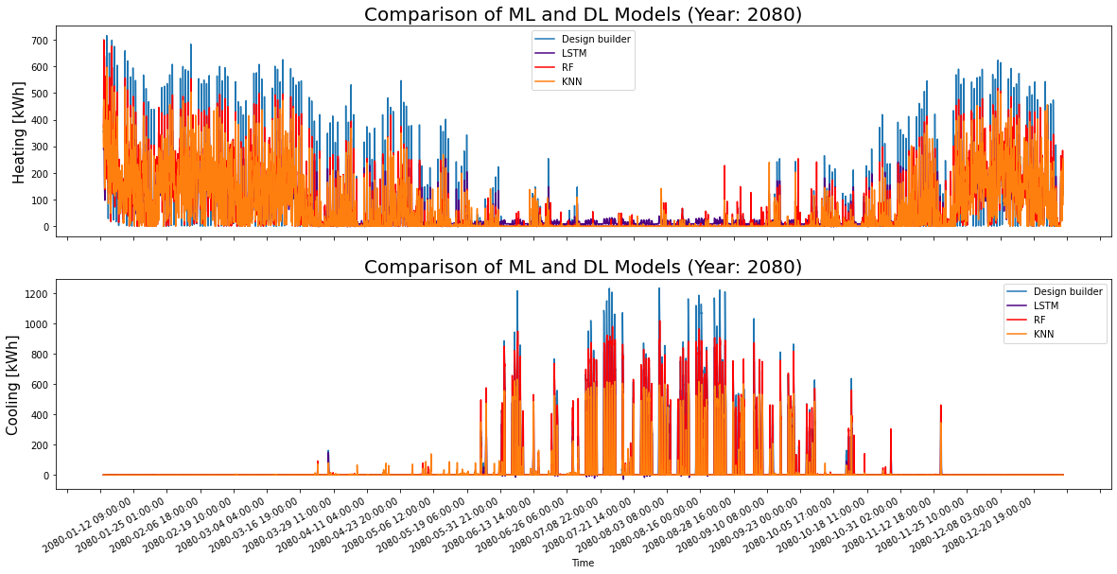
USB thermal energy demand
We used one Deep Learning model (Long-Short-Term-Memory), and two Machine Learning models (Random Forest and K-Nearest Neighbour).
The ML and DL models have been trained with the dataset of Year 2020, then they have been utilized to forecast the future performance of the USB building with different climate scenario for the year of 2080.
It was found that the LSTM and RF provided the most accurate load prediction in the DL and ML category.

Slide 21
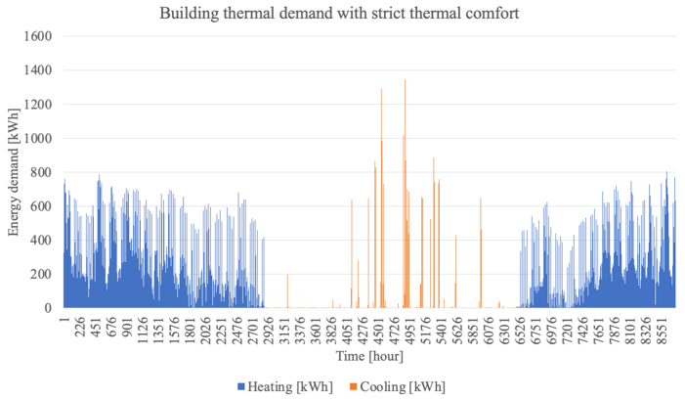
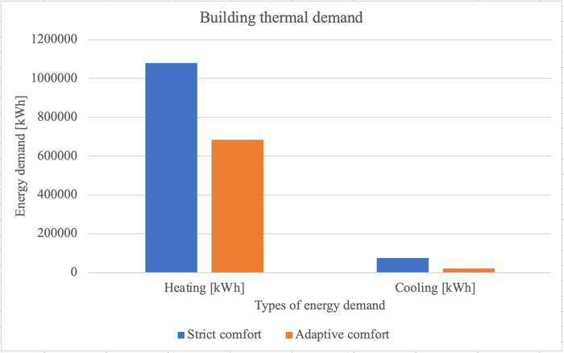
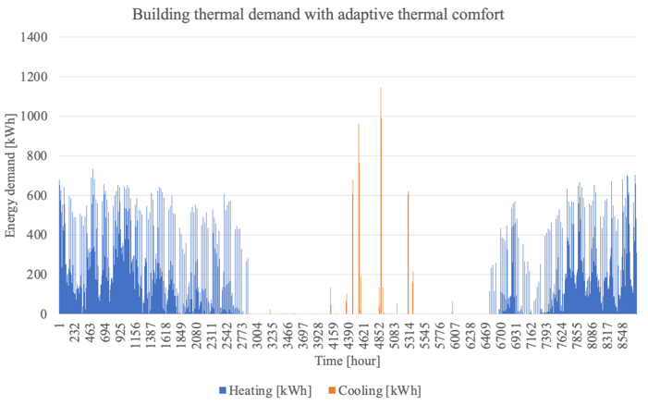
Strict vs adaptive thermal comfort
37% reduction in heating and 72% reduction in cooling energy demand

Slide 22
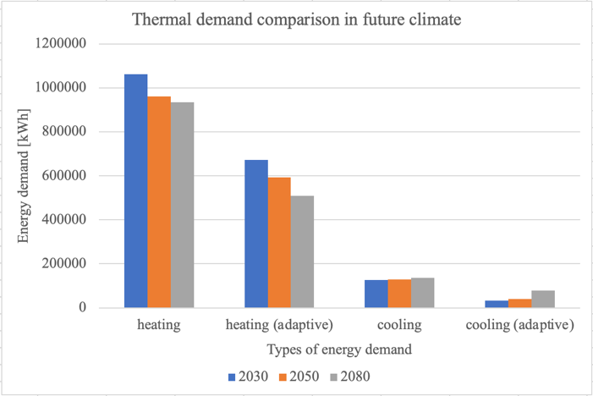
Demand now and into the future
Under all future climate scenarios, the total building energy use decreases, as the need for heating lessens.
Despite an increase in cooling demand over the decades, heating remains a much more significant part of overall energy consumption, having a share of 35% with strict comfort mode and 23% with adaptive mode in 2080. In contrast, even with strict mode, cooling is only 5% of total energy demand in 2080.

Slide 23
Understanding the borehole contribution​
​
The building load is dynamic, so one research question is to understand how the borehole might cope with this.​
​
We can model and compare the fluctuating demand or a constant heat load:
- Variable heat load – Annually, 500W (6 month injection) and -50kW (6 month extraction).
- Constant heat load – -50kW annually
After 5 years, Inlet Temperature for Constant heat load
= 5.98°C, Variable heat load = 8.3°C; ∆T = 2.32°C
Therefore, there is likely to be an increased longevity of operation if rest periods or thermal storage is incorporated.
​

Slide 24
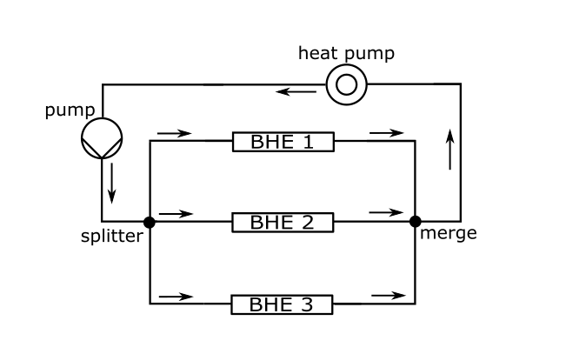
Coupling the borehole heat exchanger to a heat pump and future work
​
One way of coupling the building heat demand to the BHE is to consider the complete loop including the heat and/or water pump.
​This presents the possibility to incorporate efficiency of pumps and give a more comprehensive operational scenario.
The BHE model in OpenGeoSys can be coupled to TESPy, which models surface components such as heat pump and water pump, thereby facilitating hydraulic and thermal coupling.
Instead of specifying BHE load, OpenGeoSys also has the option of specifying building load which then incorporates a heat pump.
Future work will look at coupling the BHE model to the predicted building demand within a suitable framework such as OpenGeoSys+TESPy.
Notes:
One way of coupling the building heat demand to the BHE is to consider the complete loop including the heat and/or water pump.
​This presents the possibility to incorporate efficiency of pumps and give a more comprehensive operational scenario.
The BHE model in OpenGeoSys can be coupled to TESPy which models surface components such as heat pump and water pump thereby facilitating hydraulic and thermal coupling.
Instead of specifying BHE load, OpenGeoSys also has the option of specifying building load which then incorporates a heat pump.
Future work will look at coupling the BHE model to the predicted building demand within a suitable framework such as OpenGeoSys+TESPy

Slide 25
Building demand now
Building demand in the future
Borehole behaviour under dynamic load
Add components to better model building-borehole
Understanding the borehole contribution

Slide 26
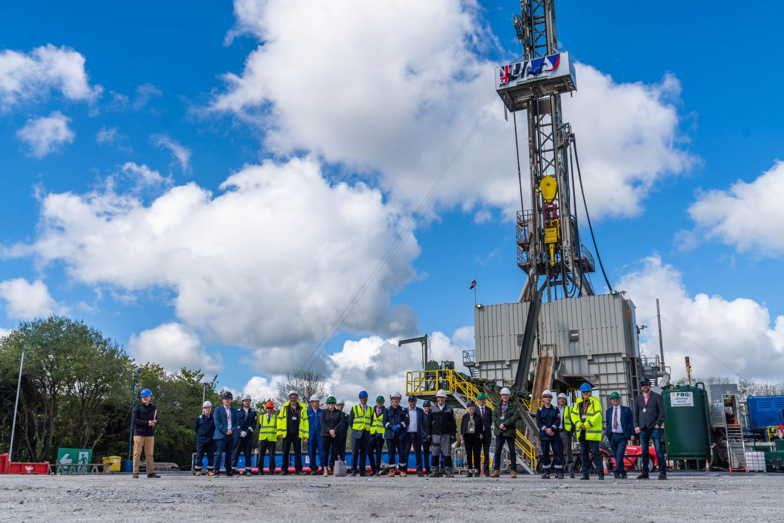
The need for regulation
Changes in the temperature of the ground/groundwater
Overabstraction of groundwater
Groundwater contamination
Environmental impact during drilling and operation
Induced seismicity
Access to geothermal resources
Management of geothermal resources
Eden Geothermal geothermal energy eden project - Bing images

Slide 27
Current regulation
Groundwater abstraction licence from Environment Agency (Water Resources Act 1991)
Environmental permit from Environment Agency for the discharge of water to the ground (Environmental Permitting Regulations 2016)
Planning permission from local authority for any building and engineering operations (Town and Country Planning Act 1990) (plus EIA for some projects)
Health & Safety legislation
Landowner permission (subject to Infrastructure Act 2015 in England)
Coal Authority consent to enter Coal Authority property
Nuisance claim for interference between operations?

Slide 28
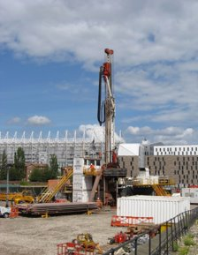
Regulatory and Legal Questions
The regulation of heat extraction
Environmental regulation
Planning permission
Tort law

Slide 29
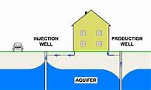
Environmental regulation
1. Water abstraction licence
Water Resources Act 1991
potential use for preventing reduction in groundwater temperature
BUT, only applies to open-loop systems
2. Environmental (discharge) permit
Environmental Permitting (England and Wales) Regulations 2016
proposed reforms mean potentially applicable to closed-loop systems
BUT covers heat discharge not extraction

Slide 30
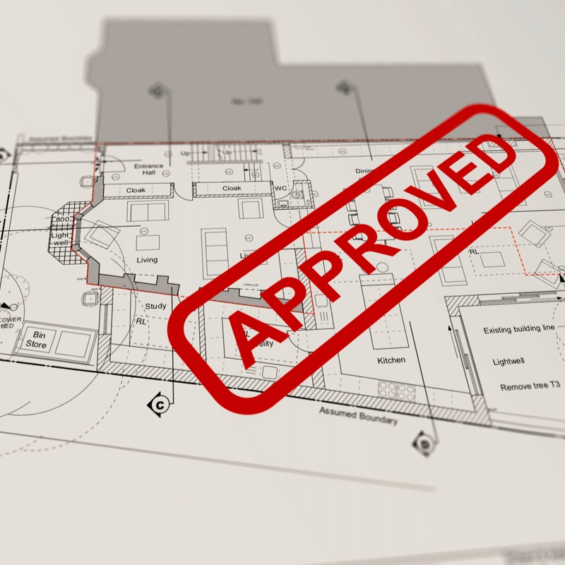
Planning permission
Town and Country Planning Act 1990
is heat extraction a planning matter?
local authority resource issues
EIA
discretionary nature of local planning authority decision-making
Tort law
- nuisance
- regulation of competing property rights
- is heat 'property'?
Insert image / diagrams here

Slide 31
Regulatory reform recommendations
Limitations of the current regulatory regime
Complex, lengthy licensing regime
Multiple regulators
Lack of Environment Agency oversight of closed-loop extraction systems
No means of managing geothermal resources

Slide 32
Regulatory reform recommendations
Recommendations
Recognition of geothermal heat as a natural resource
Regulatory body with responsibility for managing geothermal heat
More comprehensive regulation of closed-loop extraction systems
Simplified licensing regime

Slide 33

Licensing regime for heat?
Similar to oil and gas licensing?
- Petroleum Act 1998
- BUT, who owns the heat
Similar to water abstraction licensing?
- Water Resources Act 1991
- ensure sustainable extraction
- give exclusive rights
- BUT, can extraction be guaranteed?
Insert image / diagrams here

Slide 34

Conclusion
Geothermal operations are covered by a variety of different legal regimes
Currently no comprehensive regulation of the extraction of heat
Possible solution is a licensing regime for heat
Need to consider issues such as ownership of heat and ability to guarantee access to heat
Insert image / diagrams here

Slide 35
NetZero GeoRDIE
Provides a detailed evaluation of how a deep geothermal well will perform in an urban setting
Integrates demand and ability to meet demand
Highlights some of the regulatory issues
Helps to derisk future projects

Slide 36
Newcastle Helix
A unique 1640m deep borehole for geothermal research in a modern urban development

Slide 37
Informs city centre heating and cooling schemes
Contact: david.manning@ncl.ac.uk

